Slide 1
Structuring machine learning project

Slide 2
Machine learning strategy – Ideas to increase accuracy
Collect more data
Increase diversity in training set
Train algorithm longer with gradient descent
Try ADAM instead of gradient descent
Try bigger or smaller network
Try dropout
Add L2 Regularization
Modify Network architecture, Activation function or number of hidden units

Slide 3
Orthogonalisation
Control one parameter or hyperparameter to increase accuracy or decrease error
Orthogonalization = very clear-eyed what to tune in order to achieve one effect.
Assumption in ML = what should be in ML
Fit training set well on cost function ( close to human level )
Fit dev set well on cost function
Fit test set well on cost function
Performs well in real world

Slide 4
Test layers and do change on them
Try bigger network, ADAM.
If Algorithm is not doing well on dev set: Try regularization, Try with bigger training set.
If algorithm do well on dev set and not on test set: Try with bigger dev set.
Do well on test set but not in real world: Change dev set or cost function

Slide 5
Setting up yout goal using a single number evaluation metric
Use a knob principe to control hyperparameters.
Idea
Experiment
Code it!

Slide 6
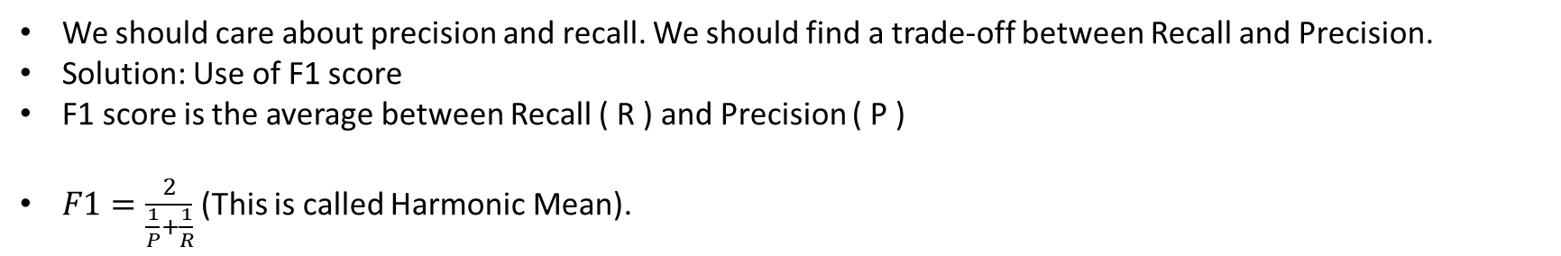
What should we choose?
Classifier | Precision | Recall
A | 95% | 90%
B | 98% | 85%
Precision: Percentage of examples that ML can exactely recognize (For example: recognation cats – where % exactly are cats?
Recall: What % of actual cats are correctly recognized.
We should care about precision and recall. We should find a trade-off between Recall and Precision.
Solution: Use of F1 score
F1 score is the average between Recall ( R ) and Precision ( P )
$F1=\frac{2}{\frac{1}{P}+\frac{1}{R}}$ (This is called Harmonic Mean).

Slide 7
Speed up iteration
Classifier | US | China | India | Others | Average
A | 3% | 7% | 5% | 9%
B | 5% | 6% | 5% | 10%
Add averages error and control it when you are implementing code. Especially when we have a lot of algorithm that are classifying.

Slide 8
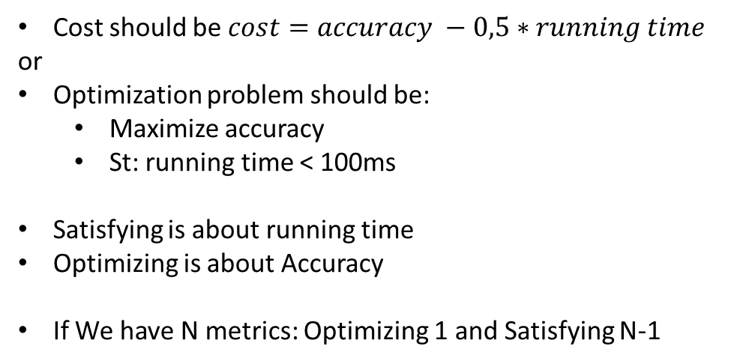
Satisfying and optimizing metrics
Classifier | Accuracy | Running time
A | 90% | 80ms
B | 92% | 95ms
C | 95% | 1500ms
Cost should be $cost=accuracy −0,5∗running time$
or
Optimization problem should be:
Maximize accuracy
St: running time < 100ms
Satisfying is about running time
Optimizing is about Accuracy
If We have N metrics: Optimizing 1 and Satisfying N-1
Example: System to detect wake words or trigger words – Voice controller as Amazon echo.
We suppose that there are 2 metrics to consider here: Accuracy and Number of false positive.
Optimization problem should be:
Maximize accuracy
St: False positive every 24 hours should be small or equal than 1

Slide 9
Train / dev / test
Cat classification from regions
US
UK
Other Europe
South America
India
China
Other Asia
Australia
Dev and test set should come from the same distribution
Solution: Randomly shuffle into dev / test sets
DEV
TEST

Slide 10
True Story
Classification of person that can have a loan: X -> y (loan yes or no)
Optimizing on dev set on loan approvals for medium income zip code.
Tested on low income zip codes.
=> 3 months of test and redo work (change target)
Conclusion: dev and test set should come from same distribution.

Slide 11
Choose size of Train/dev/test sets
Old way to split data: Train (70%) – Test (30%)
For small data set (100 to 10 000 examples): Train (60%) – Dev (20%) – Test (20%)
Modern Machine learning: Larger data set ( More than 1 000 000 examples): Train (98%) – Dev (1%) – Test (1%).
Size of test set
Test set is used to help us to evaluate how good our final system is good.
It should be big enough to give high confidence in overall performance of your system (10 000 to 100 000 examples)

Slide 12
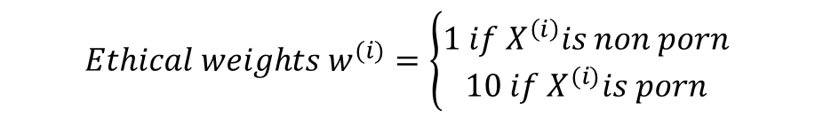
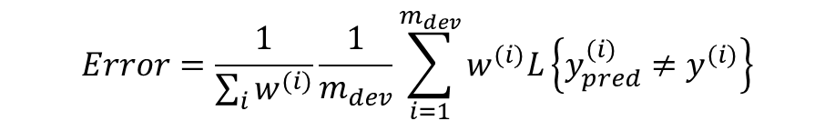
When should I change dev / test sets and metrics
Suppose this scenario: 2 algorithms of error
Metrics: classification error:
Algorithm A: 3% error
Algorithm B: 5% error but more ethic
Metric + Dev set: Prefer algorithm A
You + Users: Prefer algorithm B
Solutions for Algorithm A:
Change evaluation metrics
Change Dev set
Change test set
Add ethical Weights to your error
$$Error=\frac{1}{\sum_{i}{w^{(i)}}}\frac{1}{m_{dev}}\sum_{i=1}^{m_{dev}}{w^{(i)}L\left\{y_{pred}^{(i)}≠y^{(i)}\right\}}$$
$$Ethical weights w^{(i)}=\left\{\begin{aligned}1 if X^{\left(i\right)}is non porn \\ 10 if X^{(i)}is porn\end{aligned}\right.$$

Slide 13
Orthogonalization principe
Place the target: Define a metric and evaluate classifier
Aim accuaratly at target: how to do well on this metric.
Same dev/test set distribution
Evaluating metrics check

Slide 14
ML VS HUMAN PERFORMANCES

Slide 15
Comparing ML performances to human level performances
There is what we called : ‘ Bayes optimal error ‘. It is the error that cannot neither human nor ML do better.
Bayes optimal error may be not 0% (accuracy different to 100%)
Humans are good at lot of tasks. So long as ML is worse than humans in:
ML Get labeled data from humans
Humans Have Insight for manual error analysis
Human have better analysis of Bias / Variance than ML

Slide 16
Avoidable bias and variance
Classifier | Example 1 | Example 2
Human | 1% | 7,5%
Training error | 8% | 8%
Dev error | 10% | 10%
What should we de | Focus on avoidable bias | Focus on variance
Avoidable Bias
Avoidable Bias
Variance
Variance
Human-level error can be considered as an approximation of Bayes error (two errors are not too far).
Focus on the largest error (bias or variance)
2 things: we cannot get below than bayes error. We cannot get higher than avoidable bias error.

Slide 17
Understanding human level error
We have to consider that human-level error is close to Bayes error.
Example: Medical image classification.
Suppose that we have passed images of cells for 4 types of humans and demand them to classify these cells (begnin or malign)
Typical human: 3%
Typical doctor: 1%
Experienced doctor: 0,7%
Team of experienced doctors: 0,5%
How should we define human level error?
=> Solution: To estimate or To approach Bayes error, we should choose smaller (In this case – Team of experienced doctors).

Slide 18
Error analysis
Avoidable bias {4% , 4.5%} – variance { 1% }
Focus on Avoidable bias (Try bigger neural network)
Avoidable bias {0%}– variance { 4% }
=> Focus on variance (Try regulation or getting bigger training set)
Human level error – Approximation of bayes error
Avoidable Bias
Training error
Variance
Dev error

Slide 19
ML Surpassing human-level performances
Some times ML can surpass humans in some tasks => We cannot estimate bayes error (Some solutions: Give the probleme to expert or teams to classify).
Problems where ML significatly surpass human-level performances:
Product advertising
Product recommendations
Logistics (Predicting transit time)
Loan approvals
Some speech recognition
Some image recognition
Medical: ECG
Because of: Presence of structured data (Databases) / Not natural perception / Lots of data.

Slide 20
2 fundamental assumptions of supervised learning
Fit training set pretty well to achieve avoidable bias
Training set performances generalizeq pretty well to dev / test set => Achieve variance

Slide 21
Improve model of deep learning
To reduce avoidable bias (difference between training error and human-level error): Train bigger model / Train longer / Use better optimization algorithm / Change neural network architecture / Do hyperparameters search
To reduce variance (difference between Dev error and Training error): Search for more data / Regularization / L2 dropout / Change NN architecture /Do hyperparameters search.

Slide 22
Human Error analysis
Scenario: Look at a cat classifier (90% of accuracy – 10% of error on dev set)
Question: Should you try to make your at classifier do better on dogs?
Error analysis:
Get 100 moslabeled dev set examples
Count up how many are dogs
For example: if 5% of dog pictures are mislabeled and if we correct this mislabeled error, so error can go from 10% to 9,5%.
Evaluate multiple ideas in parallel: For example for cat detection:
Fix pictures of dogs being recognized as cat
Fix big cats (lions,panthers …) being misrecognized
Improve performances on blurry images
Supress filters. Filters can missing up the classifier
Prioritize decision ?

Slide 23
Example of human error analysis
Image | Dog | Great cats | Blurry | Comments
1 | ✓ |  |  | Pitbull
2 |  |  | ✓
3 |  | ✓ |  | Lion
% total | 8% | 43% | 61%

Slide 24
How to cleaning up incorrectly labeled data
Use of mislabled algorithms.
DL algorithms are quite robust to random error in traning set.

Slide 25
Mismatched training and dev / test set
Training and testing on different distributions:
Suppose that we are classifying images that are containing in database of 200 000 examples of images in web pages and we are testing on 10 000 examples of images in mobile apps.
We want to take care from images from mobile apps. What will be training set?
Option 1: (Not recommended) Randomly shuffle 210 000 examples and give: Train (205 000) / Dev (2500) / test (2500) [ Dev and test should have the same distribution ]
Option 2: (Recommended) Train (205 000: Web + App) / Dev (2500 App) / Test (2500 App).

Slide 26
Application in speech recognition
Case of study: Speech activated rearview mirror
Training: 500 000 examples from purchased data / smart speaker control / voice keyboard
Dev and test set: 20 000 for speech activated rearview mirror application
The distribution of data was: Train (510K from purchased data / smart speaker control / voice keyboard / speech activated rearview mirror) / Dev (5K from speech activated rearview mirror) / Test (5K from speech activated rearview mirror)

Slide 27
Bias and variance with mismatched distribution
We should add a set called training-dev set that compute the mismatched data between training and dev sets.
In general
Human level error
Avoidable Bias
Training error
Variance
Training - Dev error
Mismatched data
Dev error
Degree of overfitting
Test error

Slide 28
Addressing (correct) data mismatch
Technically: Avoid overfitting to dev set. Look only at dev set. (example: noise of car (speech recognition) – street numbers (image detection) ).
Collect more data for training set that is similar to dev / test sets. (Example: Simulate noise in-car data)
Make training data more similar => Artificial data synthesis.
For example:
clean audio (10 000 hours) + car noise (1 hour x 10 000) = synthesized in-car audio
Clean audio: (for example sentence of « The quick brown fox jumps over the lazy dog ». This sentence contain all alphabets of english.)
To conclude, if we have mismatched data: We can try Error analysis or Artificial data synthesis

Slide 29
Transfer learning
Transfert learning is about Take knowledge of the neural network has learned from one task and apply that knowledge to a separate task. (for example from image recognition to radiology diagnosis)
When use transfer learning
When I have a lot of data for the problem you are transferring from and usually relatively less data for the problem you’re transferring to.
A -> B
A and B should have same nature of input x (image, audio …)
Have more data for A than B
Low level features from A could be helpful for learning B

Slide 30
Multi-task learning
Example: Simplified autonomous driving example – Neural network can have as task to detect: pedestrian, car, stop sign and traffic light (Multiple object to detect).
When using Multitask learning
Training on a set of tasks that could benefit from having shared lower-level features
Amount of data you have for each task is quite similar
Can Train a big enough neural network to do well on all the tasks.

Slide 31
End to end deep learning
Application in speech recognition
Audio (X) -> features -> Phonemes -> words -> transcript (Y)
Phonemes are the basic units of sound. For exampl, « cat » have 3 phonemes.
End-to-end deep learning: Audio -> transcript
Challenge of end-to-end deep learning is you need to have a lot of data before it works well.

Slide 32
Application2: Face recognition
Image (X) -> detect face -> zoom in -> check identity of person (y)
End-to-end deep learning: Image (X) -> identity of person (y)
Application3: Machine translation
English -> text analysis -> … -> French
English -> Frensh
Works well in this application
Application4: Estimating child’s age
Xray image of the head -> bones -> age of child
Image -> Age

Slide 33
Uses of end to end approach
Advantages:
Let data speak
Less hand designing of components needed (less engineering work)
Cons:
May need large amount of data
Excludes potentially useful hand designed components
The question to ask: Do I have sufficient data to learn a function of the complexity needed to map x to y? If yes (end to end approach) else (hand designing approach).

